Slide 1
Overview of blockchain
2020.9

Slide 2
Outline
History of blockchain
Definition of blockchain
Architecture of blockchain
Property requirement
Applications and Ecosystem
Key technology and challenges

Slide 3
History of blockchain
A Cypherpunk’s Manifesto
DigiCash
…
Bitcoin
Ethereum
Blockchain Technology

Slide 4
A Cypherpunk’s Manifesto
Privacy in electronic age
Individuals reveal their identity when and only when desired
Only intended individuals can get information
Defend privacy in electronic age using
Cryptography
Anonymous mail forwarding systems
Digital signatures
Electronic money

Slide 5
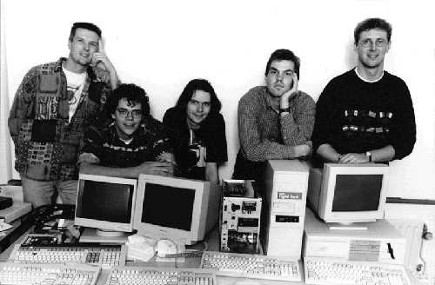

DigiCash
World’s First Digital Cash Payment (in 1994)
Applied in several merchant
Several banks
Windows 95 (failed)
The first time people know that digital data has value

Slide 6
DigiCash
Blind Signatures for untraceable payments
Bank will sign the e-cash without knowing the owner
Merchant can verify the validity through the signature
m
T(m)
A
Blind Transfer: T
B
S=Sign(T(m))
T’(S)
S
A
Deblind Transfer: T’

Slide 7
Many Attempts
E-gold, 1996
WebMoney, 1998
B-money, 1998
Liberty Reserve, 2006
Perfect Money, 2007

Slide 8
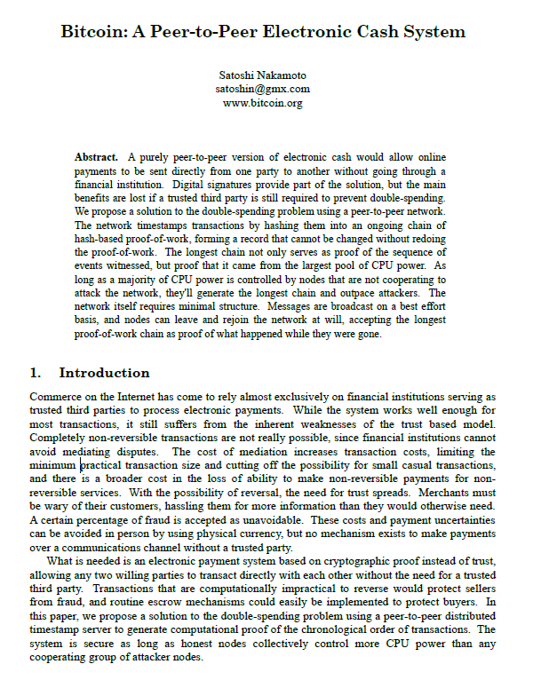
Bitcoin
Proposed in 2008
Composed of thousands of core nodes without any centralized node
Has already run for over ten years continuously
Bitcoin has realized
Public transaction record system
Decentralized currency issuance mechanism

Slide 9
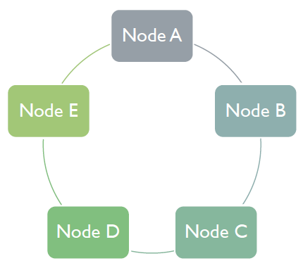
Bitcoin
Distributed public ledger
Nodes are anonymous and no certificate authority
Transactions are contained in blocks
All nodes agree to a protocol that determines the “true state” of the ledger at any point in time.

Slide 10
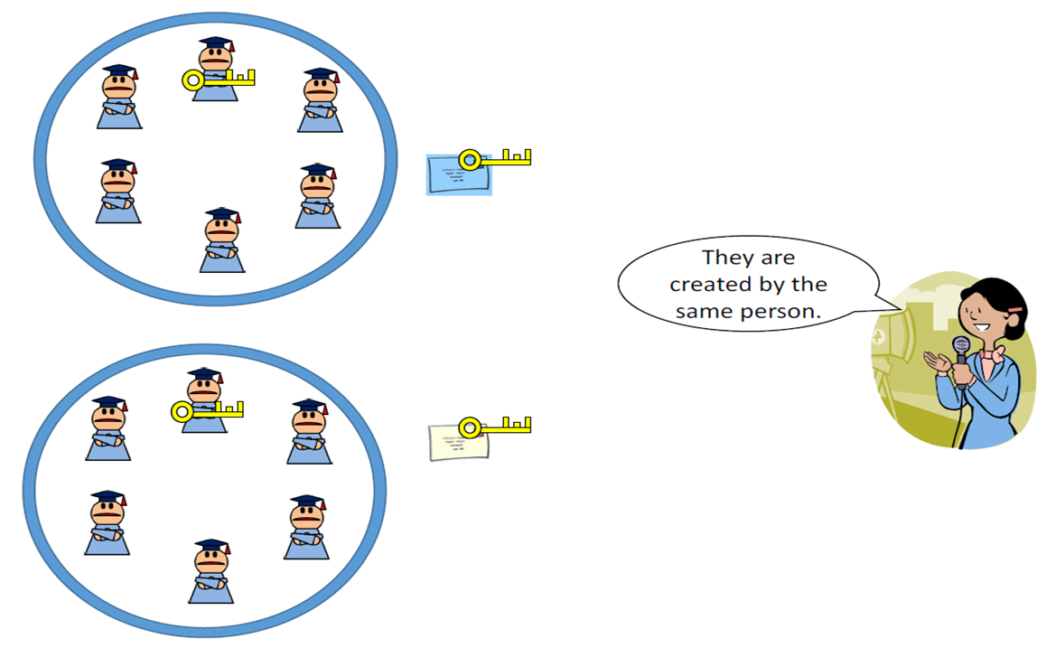
Monero
Focus on the privacy protection of transaction
Ring signature
Mixed input address and output address
Commitment
Hide the transaction fee

Slide 11
Ethereum
World’s computer
Turing complete system
Ethereum Virtual Machine (EVM)
Smart contract
Can realize almost any legal program

Slide 12
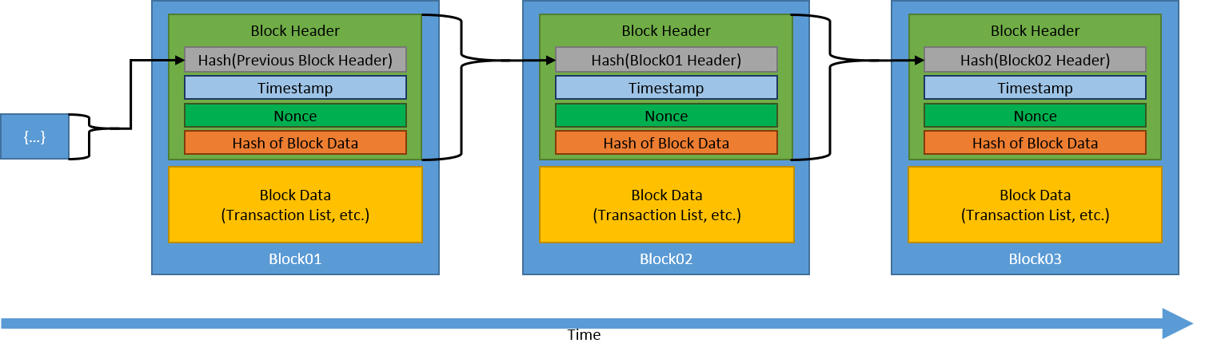
Blockchain Technique
Credit: NIST

Slide 13
Blockchain Technique
Abstract from bitcoin
Based on cryptography
Decentralized and public distributed ledger
The nodes do not trust each other
Do not care what the data is
Consider the chain structure and its property

Slide 14
Outline
History of blockchain
Definition of blockchain
Architecture of blockchain
Property requirement
Applications and Ecosystem
Key technology and challenges

Slide 15
Definition of blockchain
Blockchain is a data structure that organizes and maintains large amounts of data in a decentralized manner based on cryptography technology
Blockchain is decentralized and the data is maintained by all nodes
Each node can obtain a copy of full data record
Based on consensus algorithm among nodes, blockchain can realize the completeness and immutable of data record

Slide 16
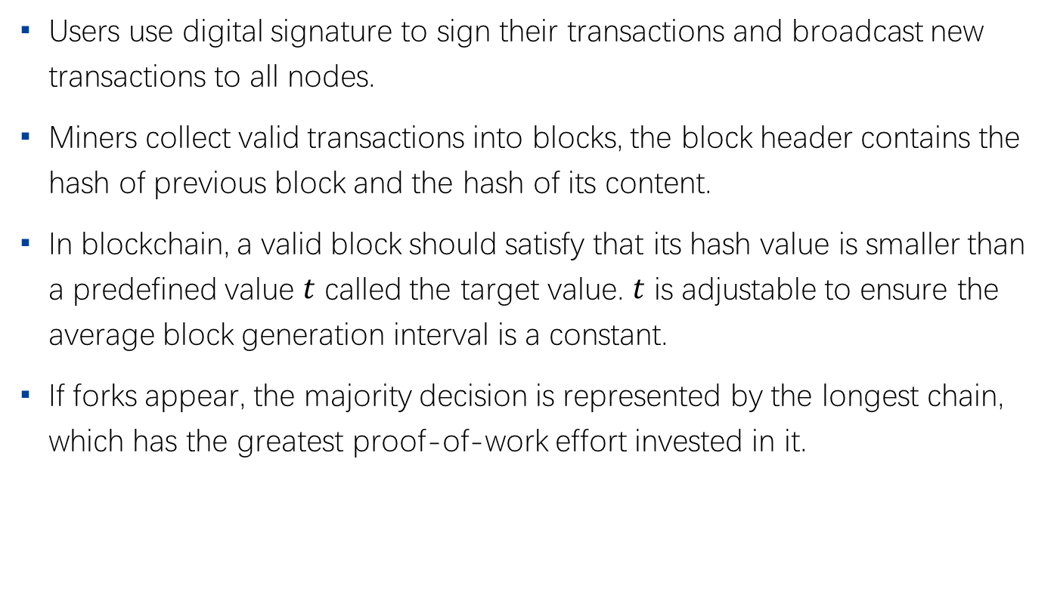
Blockchain protocol
Users use digital signature to sign their transactions and broadcast new transactions to all nodes.
Miners collect valid transactions into blocks, the block header contains the hash of previous block and the hash of its content.
In blockchain, a valid block should satisfy that its hash value is smaller than a predefined value $t$ called the target value. $t$ is adjustable to ensure the average block generation interval is a constant.
If forks appear, the majority decision is represented by the longest chain, which has the greatest proof-of-work effort invested in it.

Slide 17
Blockchain in cryptographic view
Blockchain can be regarded as multi-party computation
There are unknown number of parties
Some of them are honest and some are malicious
Each party has their own input (the current local state)
Run the MPC to get one output (the public ledger)

Slide 18

Blockchain as state machine
Blockchain can be regarded as a state machine
Append-only log
every operation $o$ appends a block of valid transactions (tx) to the log
Log content is verifiable from the most recent element
Log entries form a hash chain
$$h_{t}=Hash([tx_{1},tx_{2},…]∥h_{t−1}∥t)$$

Slide 19
Basic property of blockchain
Features of Internet
Distributed
Autonomous
Contractual
Trackable
Share
Transparency
Fair
Public

Slide 20
Blockchain classification
Permissionless
Any node can participate in the blockchain process
Permissioned
Designated nodes can participate in the block generation
Designated/public nodes can participate in the transaction and access to blocks
Private
Nodes from single institution record blocks in the form of blockchain
No need of consensus process

Slide 21
Outline
History of blockchain
Definition of blockchain
Architecture of blockchain
Property requirement
Applications and Ecosystem
Key technology and challenges

Slide 22
Architecture of Blockchain
Application layer
Digital Currency, etc
Contract layer
Smart contract, Regtech
Incentive layer
Token generation, Token reward
Consensus layer
PoW, PoS, dPoS
Network layer
P2P, Broadcast, Transaction verification
Data layer
Transaction, Merkle tree, Block, Timestamp

Slide 23
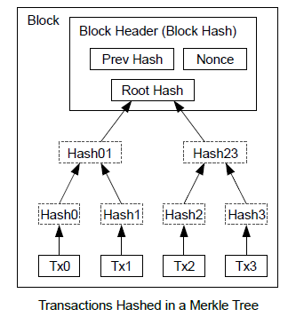
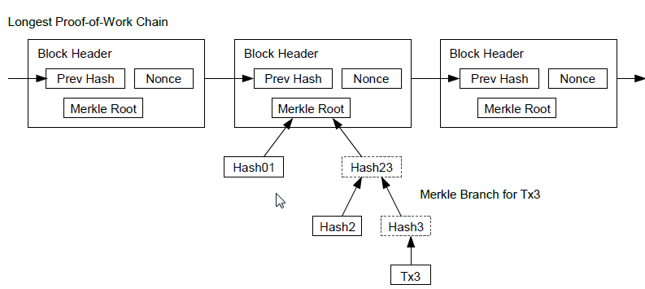
Data Layer
Digital signature
Encryption
Transaction (Data)
Merkle tree
Hash function
Timestamp
Block
Chain structure
Public ledger

Slide 24
Network Layer
Peer-2-peer
Information and services are carried out directly between nodes without the aid of intermediate links and servers
Every node generates, broadcasts, receives and verifies transactions
A node broadcasts a block once generated, and other nodes verify the validity of the block.
Technical challenges
Peer-2-peer network
Broadcast mechanism
Verification mechanism

Slide 25
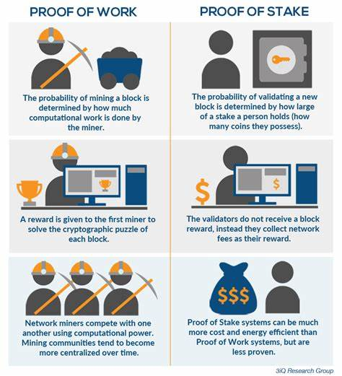
Consensus Layer
Proof of Work (PoW)
Proof of Stake (PoS)
Delegated Proof of Stake (DPoS)
Practical Byzantine Fault Tolerate (PBFT)

Slide 26
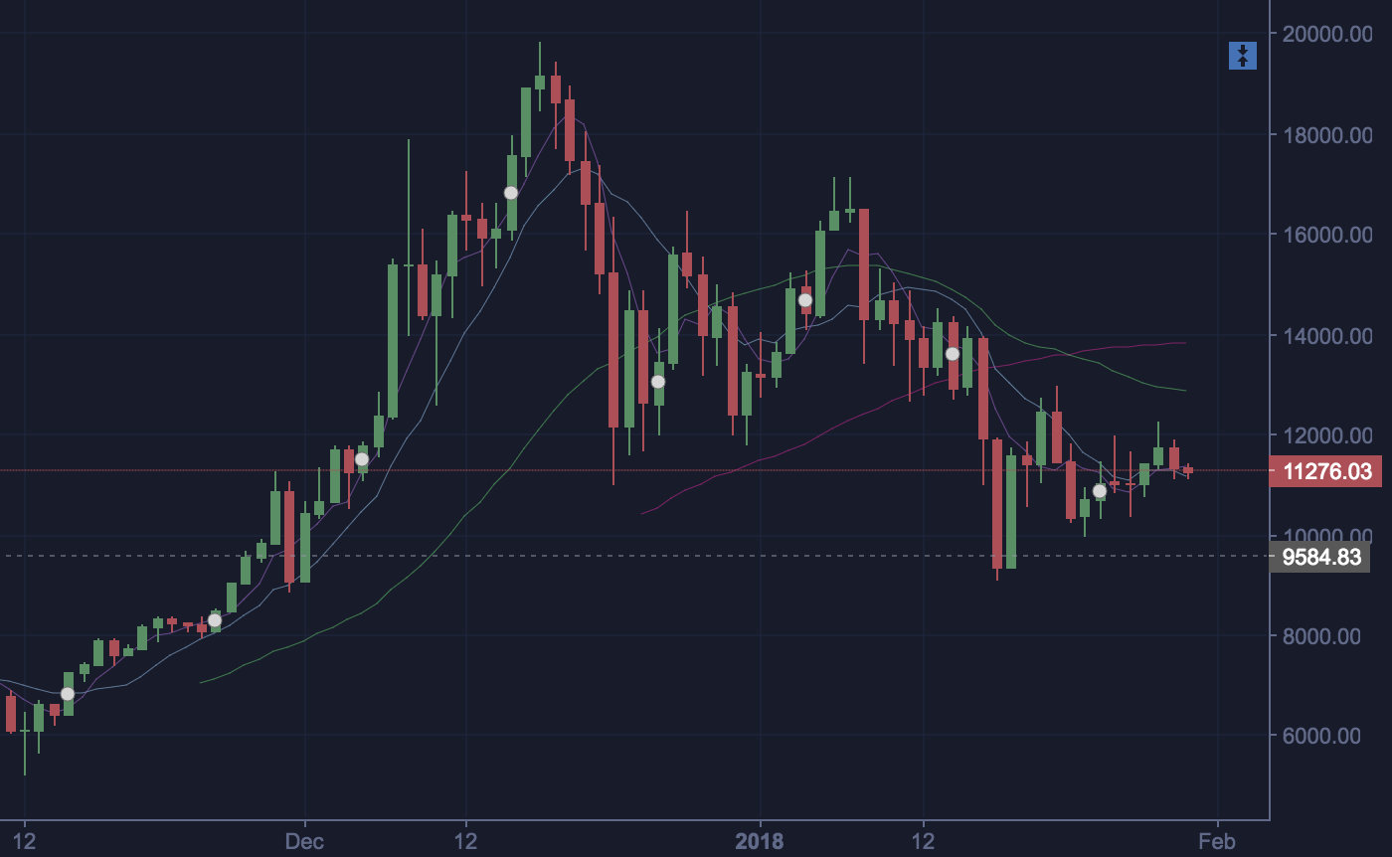

Incentive Layer
Economic incentive model
Token issue
Token reward

Slide 27
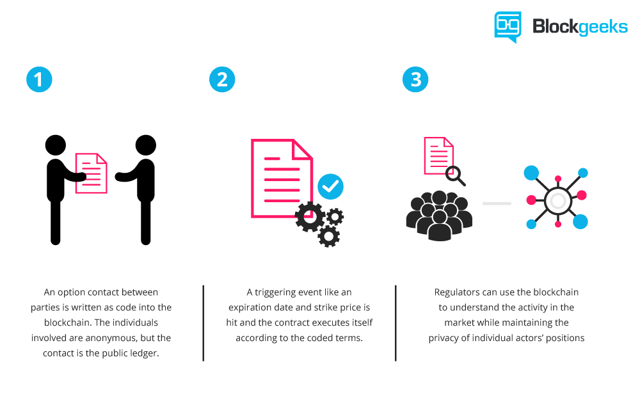
Contract Layer
Script code
Virtual machine
Smart contract

Slide 28
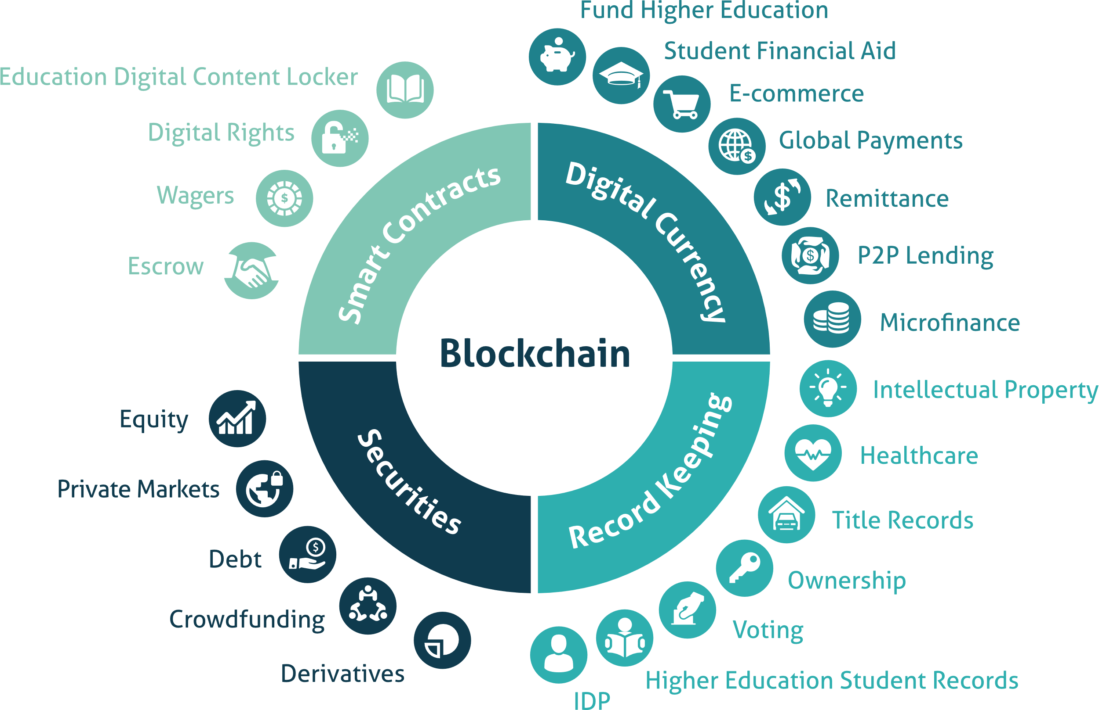
Application Layer
Financial
Payment
Clearance and settlement
Supply chain finance
Public services
Digital identity
Credit system
E-Government

Slide 29
Outline
History of blockchain
Definition of blockchain
Architecture of blockchain
Property requirement
Applications and Ecosystem
Key technology and challenges

Slide 30
Property Requirement
Decentralized/Multi-centralized
All nodes contain full copy of data in the blockchain
Traceable and non-modifiable
Records can only be added to the blockchain and are immutable
Blocks are linked in a serialized order via hash links
Independent of trusted institutions
based on mathematics and cryptography
Stable consensus and resistance to double-spending
Proof of work, Byzantine fault tolerant protocol
Smart contract
Flexible contract function, complex business logic

Slide 31
Property for each layer
Data layer
The validity of data
The redundancy of data
Network layer
The propagation cost
The synchronization of network
Consensus layer
The confirmation time
The ratio of adversary

Slide 32
Property of each layer
Incentive layer
Negative feedback
Encourage users to obey the protocol
Contract layer
The validity of contract
The supervision
The safety
Application
The scalability of system
The performance of system

Slide 33
Outline
History of blockchain
Definition of blockchain
Architecture of blockchain
Property requirement
Applications and Ecosystem
Key technology and challenges

Slide 34
Why we need blockchain
Challenges faced by traditional business networks
Each participant has its own ledger, which changes when the transaction occurs
Additional work and intermediary costs are incurred to coordinate with different parties
The entire business network relies on one or several central systems.
The network is vulnerable once a problem occurs, including fraud, network attack or error.

Slide 35
Why we need blockchain
Changes in blockchain architecture
Each participant has a shared ledger, all the ledger is changed through point-to-point replication when transaction happens
Transactions are safe, authorized, verified, and immutable based on cryptographic algorithms
Transaction can only occur when the contract conditions are met
Network participants are based on consensus mechanism to ensure that transactions are mutually verified
Business network meets government regulation, compliance and audit

Slide 36

Applications
Blockchain provides decentralized, immutable, safe and reliable features without the trusted third-party
All applications that directly or indirectly depend on the third-party guarantee trust agency may benefit from blockchain technology

Slide 37
Applications
Economy and finance
Credit
Medical treatment
Energy
Smart City/Internet of Things

Slide 38
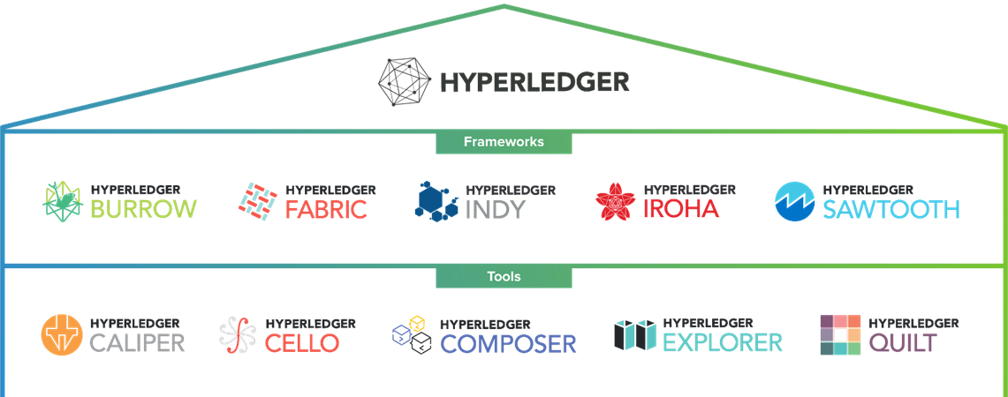
Blockchain Ecosystem
Hyperledger
BCOS
Corda
Quorum
Ripple

Slide 39
Blockchain Platform Comparison
 | Bitcoin | Ethereum | Ripple | HyperLedger
Architecture design | cryptocurrency smart contract (weak) no Turing complete smart contract development language | cryptocurrency smart contract Turing complete smart contract development language | cryptocurrency specific application no support for smart contract | General platform based on smart contract Pluggable consensus algorithm framework Build cryptocurrency Wide business application
Blockchain support | Public blockchain Permissionless Public ledger Anonymity Non auditability | Public blockchain Permissionless Public ledger Anonymity Non auditability | Consortium blockchain Permissioned Privacy of financial institute’s transactions | Consortium blockchain Permissioned Encrypted ledger Strong identity authentication Strong privacy Audictability

Slide 40
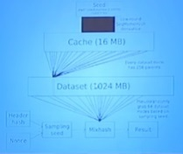
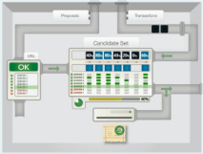
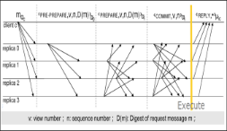
Blockchain Platform Comparison
 | Bitcoin | Ethereum | Ripple | HyperLedger
Consensus | Proof of Work: computation power consumption | Proof of Work：memory consumption | RPCA | PBFT：pluggable consensus framework Support classic PBFT, batch PBFT, SIEVE, Noops
Block Latency | 10 minutes | 15 seconds | 3-6 seconds
Throughput | 7 TPS | Hundreds | Thousands | Thousands

Slide 41
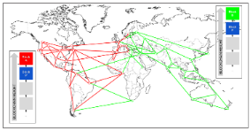
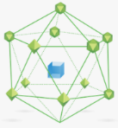

Blockchain Platform Comparison
 | Bitcoin | Ethereum | Ripple | HyperLedger
Network fault tolerance | 49% fault | 49% fault | (n-1)/5 fault | f/(3f+1) fault
Network bandwidth requirements | high |  |  | high
Network topology | avoid fork |  | avoid fork | No fork
Consumption of computing resource | CPU intensive dedicated hardware acceleration | Memory intensive dedicated hardware acceleration | Few CPU | Few CPU
New node | dynamic Download and verify full ledger

Slide 42
Outline
History of blockchain
Definition of blockchain
Architecture of blockchain
Property requirement
Applications and Ecosystem
Key technology and challenges

Slide 43
Key Technology
Information Security
Information Encryption
Privacy protection
Consensus security
Account security
Identity authentication
Access control
Game theory
Nash equilibrium

Slide 44
Key Technology
High-performance computing and communications
Improve transaction throughput
Data storage and processing
Optimize the data structure and I/O of the blockchain

Slide 45
Cryptography Application in Blockchain

Slide 46
Used Cryptographic Primitives in Blockchain
Digital signature
Zero-knowledge proofs
Access control
Encryption scheme
Secure Multiparty Computation
Secret Sharing
Commitment Scheme
Accumulator
Oblivious Transfer
Oblivious RAM
Proof of Retrievability
Post-quantum cryptography
Lightweight cryptography
Verifiable random function
Obfuscation

Slide 47
Digital Signature
Signing process
Verifying process

Slide 48
Zero-Knowledge Proof

Slide 49
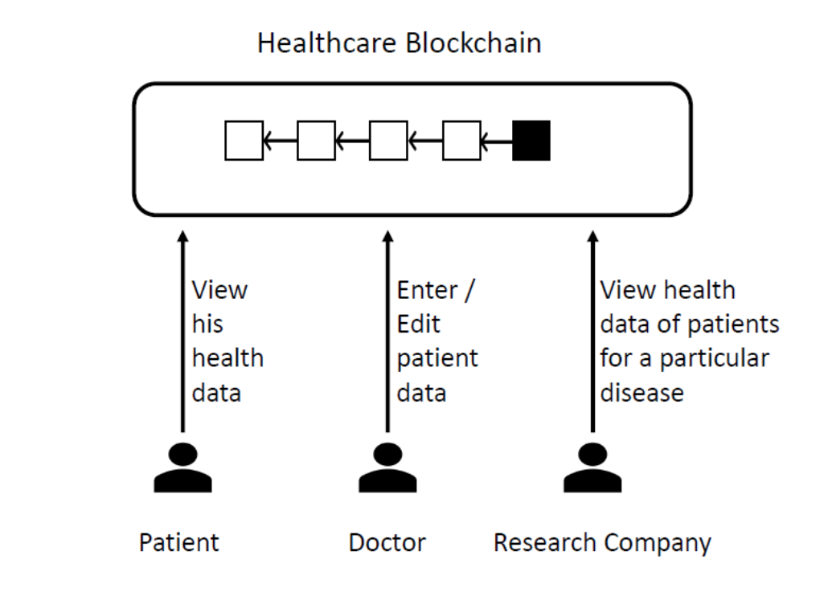
Access Control

Slide 50
Secure Multi-party Computation

Slide 51
Secret Sharing

Slide 52
Challenges
Consensus
Safety
Robustness
Effective
Proof of work
Proof of stake
Practical Byzantine fault tolerance

Slide 53
Challenges
The scalability and efficiency
Side-chain protocol/cross-chain communication
Lightning Network, Raiden Network
On-chain/off-chain intercommunication mechanism
Security analysis of theoretical model
Attacks on existing blockchain systems/platforms

Slide 54
Thank you！

